Slide 1
Exploratory Decomposition
In many cases, the decomposition of the problem goes hand-in-hand with its execution.
These problems typically involve the exploration (search) of a state space of solutions.
Problems in this class include a variety of discrete optimization problems (0/1 integer programming, QAP, etc.), theorem proving, game playing, etc.

Slide 2
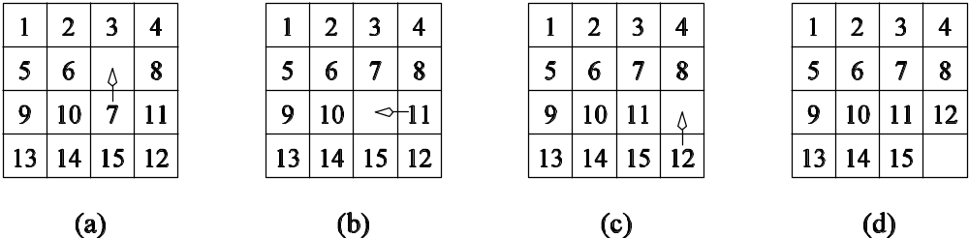
Exploratory Decomposition: Example
A simple application of exploratory decomposition is in the solution to a 15 puzzle (a tile puzzle). We show a sequence of three moves that transform a given initial state (a) to desired final state (d).
Of-course, the problem of computing the solution, in general, is much more difficult than in this simple example.

Slide 3
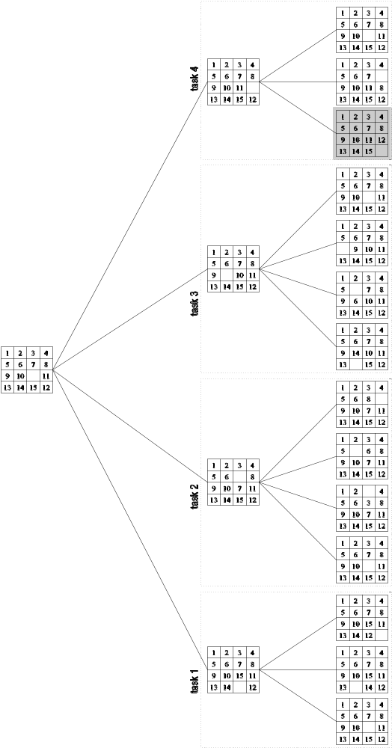
Exploratory Decomposition: Example
The state space can be explored by generating various successor states of the current state and to view them as independent tasks.

Slide 4
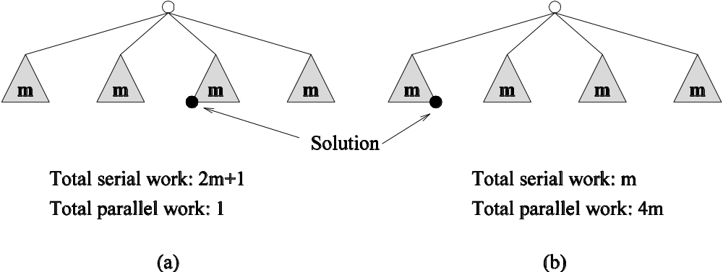
Exploratory Decomposition: Anomalous Computations
In many instances of exploratory decomposition, the decomposition technique may change the amount of work done by the parallel formulation.
This change results in super- or sub-linear speedups.

Slide 5
Speculative Decomposition
In some applications, dependencies between tasks are not known a-priori.
For such applications, it is impossible to identify independent tasks.
There are generally two approaches to dealing with such applications: conservative approaches, which identify independent tasks only when they are guaranteed to not have dependencies, and, optimistic approaches, which schedule tasks even when they may potentially be erroneous.
Conservative approaches may yield little concurrency and optimistic approaches may require roll-back mechanism in the case of an error.

Slide 6
Speculative Decomposition: Example
A classic example of speculative decomposition is in discrete event simulation.
The central data structure in a discrete event simulation is a time-ordered event list.
Events are extracted precisely in time order, processed, and if required, resulting events are inserted back into the event list.
Consider your day today as a discrete event system - you get up, get ready, drive to work, work, eat lunch, work some more, drive back, eat dinner, and sleep.
Each of these events may be processed independently, however, in driving to work, you might meet with an unfortunate accident and not get to work at all.
Therefore, an optimistic scheduling of other events will have to be rolled back.

Slide 7
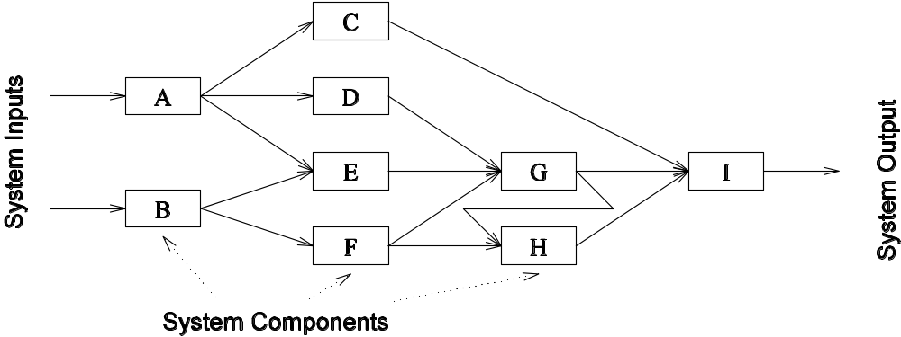
Speculative Decomposition: Example
Another example is the simulation of a network of nodes (for instance, an assembly line or a computer network through which packets pass). The task is to simulate the behavior of this network for various inputs and node delay parameters (note that networks may become unstable for certain values of service rates, queue sizes, etc.).

Slide 8
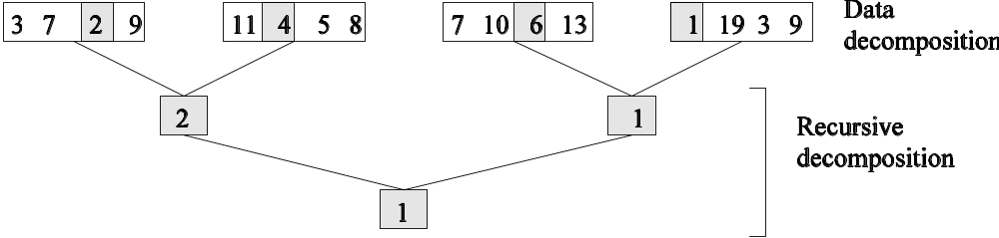
Hybrid Decompositions
Often, a mix of decomposition techniques is necessary for decomposing a problem. Consider the following examples:
In quicksort, recursive decomposition alone limits concurrency (Why?). A mix of data and recursive decompositions is more desirable.
In discrete event simulation, there might be concurrency in task processing. A mix of speculative decomposition and data decomposition may work well.
Even for simple problems like finding a minimum of a list of numbers, a mix of data and recursive decomposition works well.

